Slide 1
Date Sheet Builder

Slide 2
Agenda
Main Functions of Code
Key Components
How DateSheet Builder Look’s

Slide 3
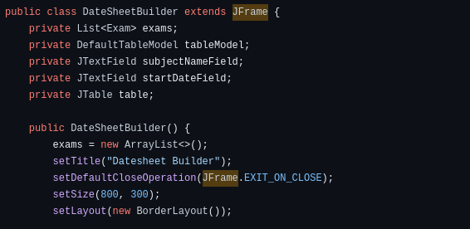
Main Functions of The Code..
The class DateSheetBuilder is used to create a Simple Application for Building a Date Sheet.
It allows users to input subject names and their respective start dates and displays them in a table format.

Slide 4
Key Components
Exam Class
CenterBoldTableCellRenderer Class
DateSheetBuilder Class (Main Class)
Exams
Table Model
Subject Name Field
Start Date Field
Table
Add Exam Button

Slide 5
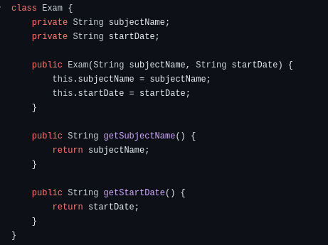
Exam Class
This class represents an
exam class with attributes for
subject name and start date.

Slide 6
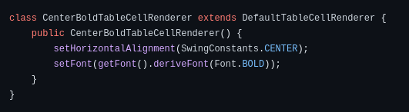
CenterBoldTableCellRenderer Class
This class is a custom cell renderer used to center-align and make text bold in table cells.

Slide 7
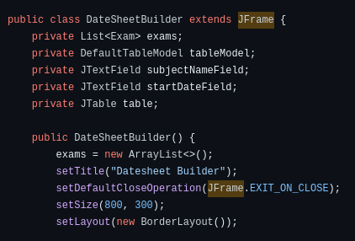
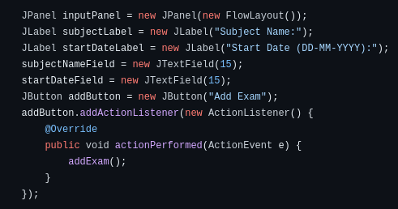
DateSheetBuilder Class (Main Class):
This class represents the main application window and contains the following components:

Slide 8
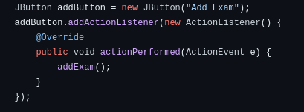
Add Exam Button
Allows Users to Add the Subject to the Table

Slide 9
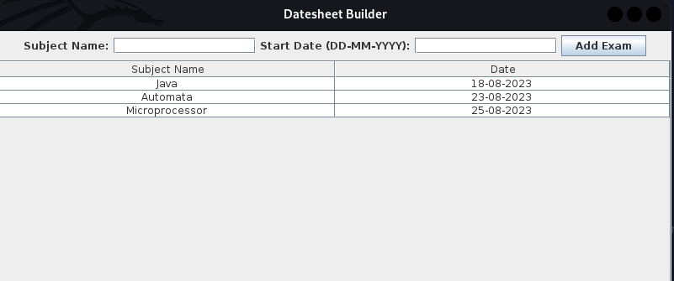
How DateSheet Builder Look’s

Slide 10
Thank you !

